Slide 1
State Health Official Letter: Streamlining Medicaid Enterprise Systems
Advanced Planning Document (APD) and Operational APD Templates
MES Community of Practice
Jessica Dunlap
September 2026
Notes:
Good afternoon, everyone, and thank you for joining us. Today----- we're going to walk through the new Medicaid Enterprise Systems APD and OAPD templates that were released after receiving PRA approval and in conjunction with the State Health Official Letter sent on August 6, 2025. Our goal today is really to help you understand what has changed, what CMS is looking for when you use these templates, and even though we have already transitioned, we hope to make it a little easier.
As we go through the presentation, we'll spend some time looking at the templates themselves and talking through the individual sections. I'll also point out some areas where we've received questions or where additional context may be helpful. And of course, we'll leave time at the end for questions.

Slide 2
Objectives
This session provides an overview of the Medicaid Enterprise Systems (MES) Advanced Planning Document (APD) and Operational APD templates.
​
At the end of the session, attendees will:
Understand the major changes to the APD and OAPD templates
Understand how to prepare a complete and internally consistent APD or OAPD submission
Recognize common issues that can delay CMS review, and understand where to go for additional support and resources
Notes:
So, just a quick look at what we hope to accomplish today.
First, we'll walk through the major changes to both the APD and OAPD templates so you can see what's different and understand the intent behind those changes.
Then we'll spend some time going through the templates themselves. Rather than just reading through each section, we'll talk about what we're looking for and highlight some of the areas where additional explanation may be helpful.
And finally, we'll make sure you know where to find the templates, guidance, and other resources after today's session.
The goal is that when you leave today, you not only know what's in the new templates, but you also have a better understanding of how to use them and what to expect when you're preparing your submissions.

Slide 3
Overview of Major Changes in the APD Template
APD template now has standard sections for all APDs submitted by states.
APD template now supports four (4) high-level APD submission types:
  Planning APD
  Implementation APD
  APD As Needed
  APD Update
APD template now allows submitting funding requests for both MMIS and E&E projects in the same document.
The release of these templates does not change the flexibility available to states to include multiple modules, systems, or projects within a single APD, as appropriate.
Notes:
There are a few major changes I want to highlight here.
First, we now have one standardized APD template that supports the four primary submission types you see on the slide. You'll see throughout the template that the guidance changes depending on the type of submission, so not every section is necessarily going to look the same for every APD.
I also want to clarify that a standardized template does not mean that CMS expects one APD per project or per module. States still have flexibility in how they organize their submissions. One APD can include multiple projects or modules, and it can include both MMIS and E&E work.
The important thing is that the scope, budget, schedule, outcomes, and supporting documentation tell a consistent story and allows CMS to understand what we're being asked to approve.
And when multiple projects are included in one APD, we still need to be able to distinguish those projects for things like budgets, milestones, status, and certification activities where applicable.

Slide 4
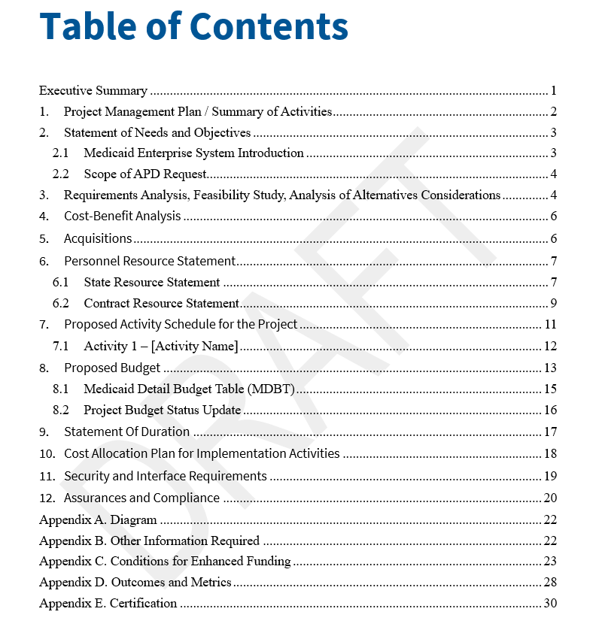
APD Template Table of Contents
New APD template standardized sections promote improved and more efficient reviews.
Notes:
This is the Table of Contents for the new APD template.
Think of this as your roadmap.
Each section has a specific purpose, and the instructions throughout the template tell you what CMS is looking for based on the type of APD you're submitting.
One of the best tips we can give you is to use those instructions. If you're unsure what belongs in a section, start there.

Slide 5
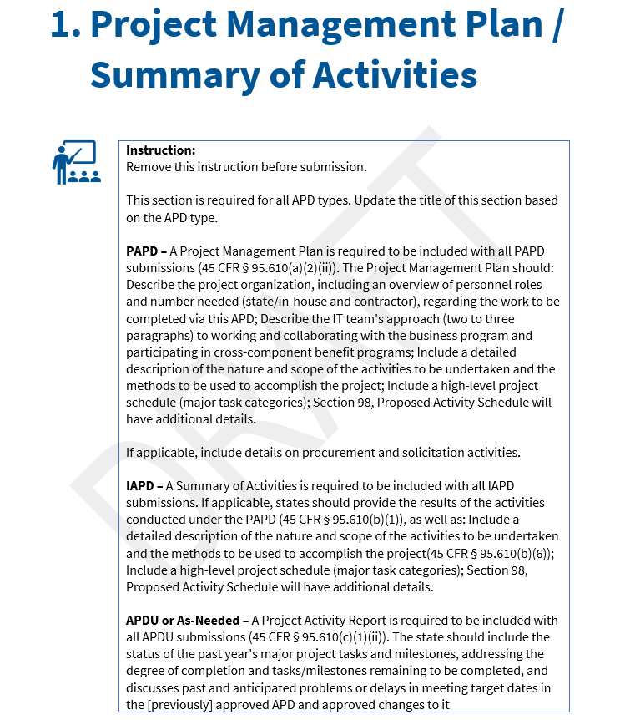
APD Template Sample Section
APD template contains guidance to states about the section content based on the APD type.
Notes:
And this is an example of what we mean by the instructional language in the template.
The guidance within each section is intended to help you understand what information CMS is looking for and how that may differ depending on the type of APD you're submitting.
I would encourage you to use these instructions almost like a checklist. Before you move on from a section, ask yourself: Did we answer what the template is asking? Did we provide the information applicable to our type of submission? And does this information align with what we've provided elsewhere in the APD?
That last piece is especially important. CMS reviews the submission as a complete package, so the narrative should tell the same story as your schedule, budget, Medicaid Detailed Budget Table, outcomes and metrics, and supporting documentation.
And if you're looking at the instructions and you're not sure how they apply to your particular situation, reach out to your State Officer. We'd much rather have that conversation with you up front than have you spend time trying to interpret how something applies and potentially have to address it later during the review.

Slide 6
Crosswalk of Standard Sections in APD Template (part 1)
Old E&E IAPD Template | New MES APD Template | What Changed
Supports E&E Implementation Advance Planning Document submissions | Supports MMIS and E&E Planning, Implementation, Update, As-Needed Advance Planning Document submissions | General change for all sections includes references to both MMIS and E&E type submissions.
Section I: Executive Summary | Executive Summary | No change to content.
Section II: Results of Activities Included in the PAPD | 1. Project Management Plan / Summary of Activities | Added guidance for four APD types. Added Project Management Plan for PAPD. Expanded Summary of Activities across IAPD, APDU, and APD As-Needed.
Section III: Statement of Needs and Objectives of the IAPD | 2. Statement of Needs and Objectives | Added guidance for content specific to APD type. Added sections for Medicaid Enterprise System Introduction and Scope of APD Request.
Section IV: Requirements analysis, feasibility study, and Alternative Considerations | 3. Requirements Analysis, Feasibility Study, Analysis of Alternatives Considerations | Added guidance for PAPD that state commits to preparing an Analysis of Alternatives for PAPD submissions in addition to a needs assessment, feasibility study and functional requirements or general systems design with supporting system diagram (Appendix A). Added guidance for IAPD, APDU and As-Needed APD types of the expectations to submit or update the same information from the PAPD.
Section V: Cost Benefits Analysis | 4. Cost-Benefit Analysis | No change to content.
Section VI: Nature and Scope of Activities | (Moved to Section 7. Proposed Activity Schedule for the Project) | Moved to Section 7 but no change to content.
Section VII: Project Management Planning and Procurement | 5. Acquisitions | Changed focus to acquisitions as PMP is moved to Section 1 of the new template.
Section VIII: Personnel Resource Statement | 6. Personnel Resource Statement | No change to content.
Section IX: Proposed Activity Schedule | 7. Proposed Activity Schedule for the Project | No change to content.
Section X: Proposed Budget | 8. Proposed Budget (MDBT) | Added sample MDBT to this section. Moving it from Appendix A in the old E&E template.
Notes:
These next two slides provide a crosswalk for those of you familiar with the previous E&E template.
I'm not going to walk through every row, but I do want you to see that much of the underlying information CMS needs hasn't fundamentally changed.
What's changed is how that information is organized within one standardized template that supports both MMIS and E&E submissions.
You'll also see some changes in where information lives—for example, the Project Management Plan is now in Section 1, the Analysis of Alternatives is more explicitly incorporated into Section 3, and the Medicaid Detailed Budget Table is incorporated into the proposed budget section.

Slide 7
Crosswalk of Standard Sections in APD Template (part 2)
Old E&E IAPD Template | New MES APD Template | What Changed
 | 9. Statement Of Duration | New content.
Section XI: Cost Allocation Plan for Implementation Activities | 10. Cost Allocation Plan for Implementation Activities | No change to content.
Section XII: Security, Interface, Disaster Recovery, and Business Continuity Planning | 11. Security and Interface Requirements | Removed explicit reference to disaster recovery and business continuity planning as those are addressed by CEF 18 in Appendix C.
Section XIII: Conditions and Standards for Receipt of Enhanced FFP | (Moved to Appendix C. Conditions for Enhanced Funding) | Moved to Appendix C.
Section XIV: IAPD Required Federal Assurances | 12. Assurances and Compliance | Updated to reflect current regulatory citations.
Appendix A (MDBT) | Appendix A. Diagram | New content. Diagram reference from Section 3.
Appendix B (E&E STAFF) | Appendix B. Other Information Required | Other information such as the Analysis of Alternatives if not submitted as a separate document.
Appendix C (ACQUIS Checklist) | Appendix C. Conditions for Enhanced Funding | Removed acquisition checklist and replaced with Conditions for Enhanced Funding attestation.
 | Appendix D. Outcomes and Metrics | New content on CMS required outcomes and state defined outcomes and metrics.
 | Appendix E. Certification | New content on determination if work defined in the APD requires certification.
Notes:
And this is the remainder of that crosswalk. Again, I'm not going to go row by row.
I mainly want to call your attention to the appendices at the bottom, particularly Conditions for Enhanced Funding, Outcomes and Metrics, and Certification.
We'll come back to the appendices later, but the main takeaway from these two slides is that the new template reorganizes and standardizes the information rather than completely reinventing what CMS needs from states and territories.

Slide 8
Overview of Major Changes in the OAPD Template
OAPD template is new and only for submitting Operational APDs.
  Regs are not new, template is new.
New OAPD template contains three (3) sections of required content
  Summary of Activities
  Acquisitions
  Annual Budget
Simplifies annual update submissions and aligns with 45 CFR 95.610(c)(3)
Notes:
The first thing I want to emphasize is that while the OAPD template is new, the underlying regulatory requirements are not.
The new template is really intended to simplify and standardize the annual operational update.
You'll notice there are only three required content sections: Summary of Activities, Acquisitions, and the Annual Budget. So compared to the APD, this is intentionally a much more streamlined submission.
One area that can cause some confusion is determining which template to use for an annual update. The fact that it's an annual update doesn't automatically make it an OAPD. The key question is: what phase is the project in?
If the project is still in implementation, the state must continue to submit an annual Implementation APD Update using the APD template.
Once the project or system has transitioned into operations, the OAPD template is the appropriate vehicle for the annual operational update.
So when you're deciding which template to use, think about the phase of the project—not simply whether you're submitting an annual update.

Slide 9
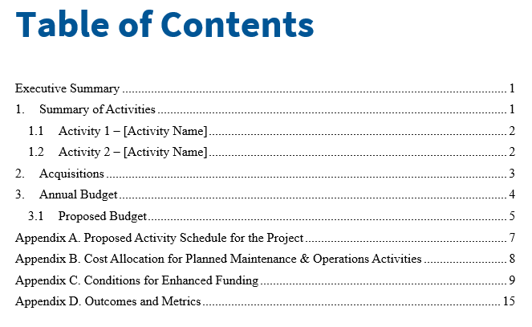
OAPD Template Table of Contents
New OAPD template standardized sections promote simpler and more efficient reviews.
Notes:
Here you can see the same standardized approach as in the APD. The big difference is how streamlined it is, with only those three required content sections that we mentioned.

Slide 10
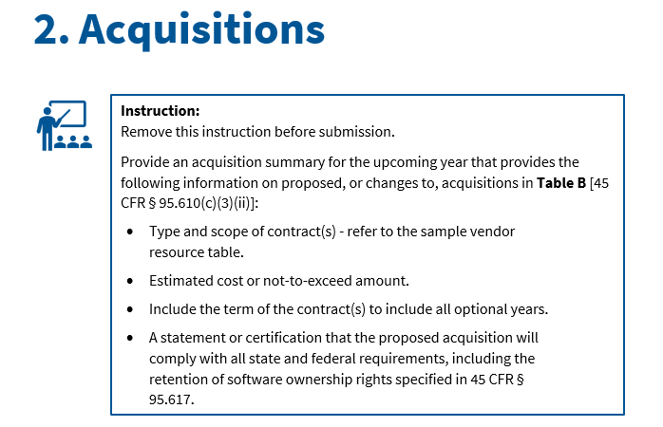
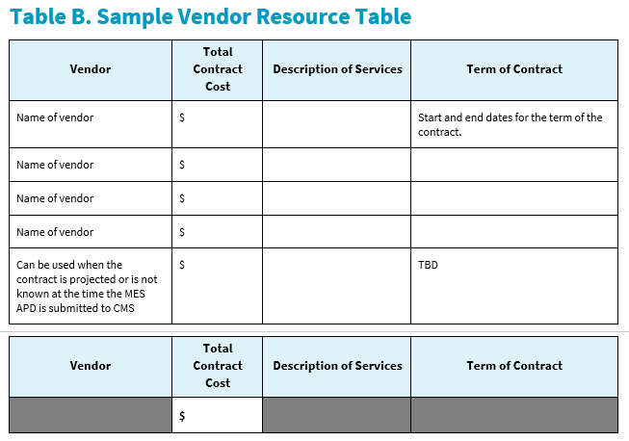
OAPD Template Sample Section
OAPD template contains guidance to states about the section content.
Notes:
And just like the APD, you'll see instructions within each section of the OAPD to help you understand what CMS is looking for.
Use those instructions as you're preparing your submission.
They're there to help guide you through what needs to be included.

Slide 11
Expectations
States were expected to begin using the new templates with submissions after July 1, 2026.
States should submit Planning APDs (PAPD) rather than Implementation APDs (IAPD) for their initial budget request.
New templates contain informational guidance for each section to help states understand the expected content and provide regulatory reference to why the content is required.
APD template contains more required content because of its intended use.
OAPD template has reduced required content as it is an annual submission, and that is how it is defined by reg.
The Annual APDU is due 60 days prior to the expiration of the FFP approval.
Notes:
There are a few expectations I want to highlight before we get into the individual sections.
States were expected to begin using the new templates for submissions after July 1, 2026, and initial budget requests should begin with a Planning APD rather than an Implementation APD.
You'll also notice a significant difference in the amount of information requested in the OAPD versus the APD. That's intentional. AGAIN_The OAPD is an annual operational submission and is much more streamlined.

Slide 12
One Submission, One Story
All parts of the submission should describe the same scope, funding request, and timeline.
Transmittal / Email
APD / OAPD Narrative
Budget Section
Project MDBT(s)
What is CMS being asked to approve?
What period and amount are requested?
Scope and activities
Project dates
Funding levels and cost allocation
Federal and state costs
FFP rates
Medicaid allocation
Same projects
Same amounts and fiscal years
Same funding story
The project-specific MDBT structure does not require one APD per project. States may still include multiple projects and/or modules in a single APD when appropriate — the supporting MDBTs simply need to reconcile to the APD.
Notes:
This is a point I really want to emphasize because it's something that can make the review process much smoother: one submission should tell one story.
When CMS receives your submission, we're not looking at the APD in isolation. We're looking at the entire package.
The scope and funding request described in your detailed transmittal letter, and your email should align with what's described in the APD, the budget section, and the Medicaid Detailed Budget Table. The projects, amounts, fiscal years, FFP rates, and timelines should all reconcile across those pieces.
If one document tells us you're requesting one amount or period of funding and another tells us something different, we have to stop and reconcile which one represents the actual request, and that's likely going to result in questions back to the state.
I also want to reinforce the point at the bottom of the slide. The project-specific structure of the MDBT Table does not mean CMS expects a separate APD for every project. You can still include multiple projects or modules within one APD when that makes sense.
We just need to be able to clearly connect each project's activities, costs, and timeline back to the overall request.
So if there's one thing to take away from this slide, it's this: before you submit, look at the package as a whole and make sure every piece is telling CMS the same story.

Slide 13
Before You Submit: Common CMS Review Checks
A quick quality-control review can prevent avoidable questions and rework.
Templates
Are we using the latest APD/OAPD and project MDBT templates?
Schedule
Are project plan dates still realistic as of the actual submission date? Keep in mind the review can last up to 60 days
Consistency
Do the transmittal, narrative, budget section, and MDBT(s) request the same amounts and describe the same scope?
Outcomes & Metrics
Are required outcomes and metrics addressed, including how reporting transitions for replacement efforts?
FFP
Do the requested FFP levels align with the activities and prior-year funding, or are significant changes clearly explained?
Instructions
Did we answer what the template instructions ask for?
Cost Allocation
Does the Medicaid allocation percentage reasonably reflect who benefits from the system or activity? Is it consistent with your DHHS public assistance cost allocation plan?
Early Coordination
If something is unclear, have we shared a draft or question with the State Officer before formal submission?
Two easy-to-miss “gotchas”
Dates age quickly: a milestone that looked reasonable when drafting began may be unrealistic by the time CMS reviews the submission.
Replacement efforts: make clear when the legacy system stops reporting outcomes/metrics and when the replacement system begins.
Notes:
Before we get into the individual sections of the template, I want to spend a minute on some common things CMS looks at during review.
I'm not going to read through every item on this slide, but these are good quality-control checks to do before you submit. A few minutes spent looking at the package as a reviewer can prevent questions and rework later.
We've already talked about consistency—making sure the transmittal letter, email, narrative, budget, and MDBT Tables are all describing the same request.
I would also pay particular attention to your FFP rates and cost allocation. Make sure the match rate you're requesting aligns with the activities being performed, and that your Medicaid allocation reasonably reflects who benefits from the system or activity.
There are also two easy-to-miss “gotchas” at the bottom.
The first is dates. A milestone that made sense when you started drafting the APD may no longer be realistic by the time the submission reaches CMS. Since CMS review can take up to 60 days, take one last look at your dates before you submit.
The second is replacement efforts. If you're replacing a system that's already reporting required outcomes and metrics, make it clear when the legacy system will stop reporting and when the replacement system will begin. We don't want an unexplained gap in reporting during that transition.
And finally, if something isn't clear, reach out to your State Officer before formal submission. Early coordination can save everyone time during the review.

Slide 14
APD Template Sections
Notes:
Now that we've covered the overall structure and some of the common things to keep in mind when preparing your submission, let's walk through the individual sections of the APD template and highlight what CMS is looking for in each.

Slide 15
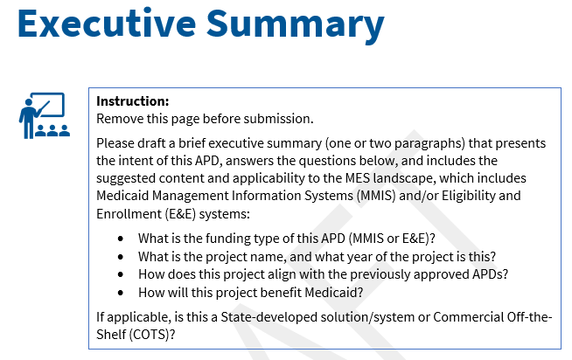
APD Section Executive Summary
Notes:
We'll start with the Executive Summary.
This should be brief—really one or two paragraphs that orient the reviewer to what you're submitting and what you're asking CMS to consider.
You don't need to repeat everything that's going to appear later in the APD. Think of this as giving the reviewer enough context at the beginning to understand the request: what the project is, are there sole source requests incoming, where it fits within your Medicaid Enterprise Systems environment, how it relates to previously approved work, and how it benefits the Medicaid program.
One thing I personally find very helpful—and that I encourage states and territories to include—is a clear statement of the funding being requested. Tell us the amount you're requesting, the applicable period, and, if the request reflects an increase or decrease from previously approved funding, and to clearly identify that change.
That gives the reviewer a financial snapshot of the request right up front. We should be able to understand what you're asking CMS to approve without having to work through the entire document first to figure out the bottom line.
And, of course, those amounts should align with the budget section, Medicaid Detailed Budget Table, and the rest of the submission. Again, one submission, one story.
By the time we finish the Executive Summary, we should have a good understanding of what the rest of the APD is going to be about.

Slide 16
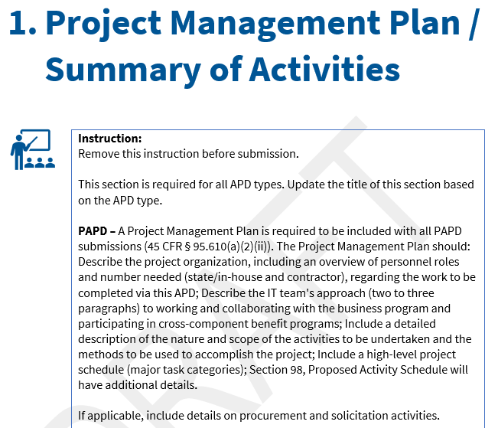
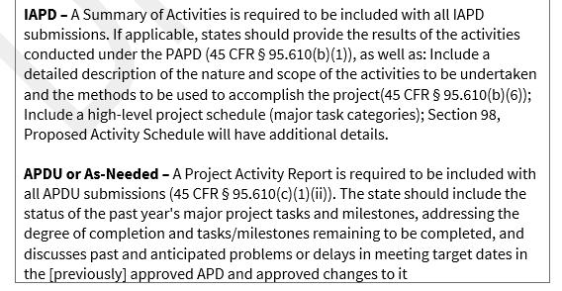
APD Section 1. Project Management Plan / Summary of Activities
Notes:
Section 1 is required for all APD types, but what you provide here depends on the type of APD you're submitting.
For a Planning APD, this is your Project Management Plan. This is where you're laying out how you intend to manage the project—the organization, roles and responsibilities, approach, scope of activities, and high-level schedule.
For an Implementation APD, this becomes the Summary of Activities. If you previously had an approved Planning APD, tell us what was accomplished during that planning period and then describe the activities you're proposing as you move into implementation.
For an APD Update or an As-Needed APD, this section functions more as a Project Activity Report. We want to understand where the project stands—what you've accomplished, what's still outstanding, and whether there have been problems, delays, or changes from what CMS previously approved.
The important thing here is to use the instructions for your particular submission type. Don't feel like you need to respond to every piece of instructional language on this slide if it doesn't apply to the APD you're submitting.
And particularly for updates, this is a good opportunity to tell us what's changed. If your schedule has moved or something hasn't gone as planned, explain it here rather than making the reviewer figure it out by comparing the current submission to the previous approval.

Slide 17
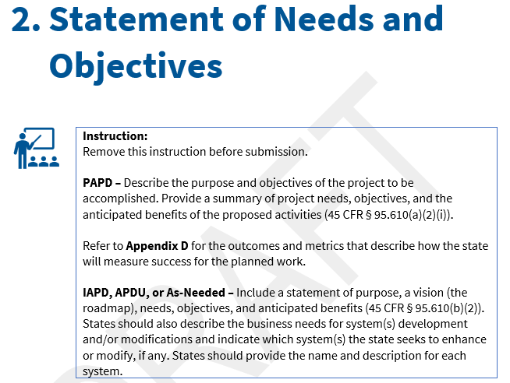
APD Section 2. Statement of Needs and Objectives
Notes:
Section 2 is the Statement of Needs and Objectives, and this is really where we want to understand the “why” behind the project.
What problem or business need are you trying to address? What are you trying to accomplish? And what benefit do you expect the Medicaid program to receive from this investment?
For a Planning APD, you're establishing the project needs, objectives, and anticipated benefits. For an Implementation APD, Update, or As-Needed submission, we also want to understand the roadmap and the specific system or systems you're proposing to develop, enhance, or modify.
One thing I would encourage you to do here is be specific. Statements like “improve efficiency” or “modernize the system” don't tell us very much on their own. Tell us what needs to improve and what success should look like.
And those objectives should carry through the rest of the submission. The activities you're proposing, the funding you're requesting, and ultimately your outcomes and metrics should all connect back to the needs and objectives you've identified here.
Again, we're looking for that consistent story throughout the APD.

Slide 18
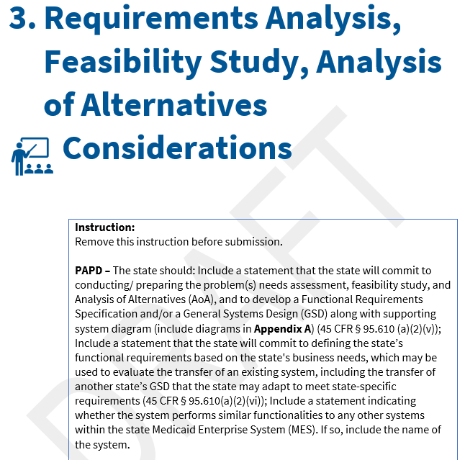
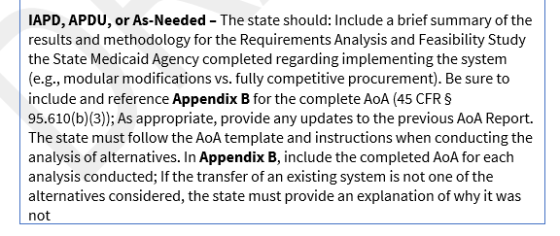
APD Section 3. Requirements Analysis, Feasibility Study, Analysis of Alternatives Considerations
Notes:
Section 3 covers the Requirements Analysis, Feasibility Study, and Analysis of Alternatives.
For a Planning APD, you're essentially committing to do this work as part of the planning process. That includes identifying the problem or need, evaluating feasibility and alternatives, developing functional requirements or a general systems design, and considering whether existing systems or shared solutions could meet the state's needs.
Then, when you move into an Implementation APD—or when this information needs to be updated in an APD Update or As-Needed submission—we're looking for the results of that work and the methodology used.
One thing I specifically want to point out here is the Analysis of Alternatives template. When conducting the Analysis of Alternatives, states should use the AoA template and follow the instructions provided with it. The completed AoA should then be included in Appendix B, as applicable.
The AoA is important because we want to understand not only what solution you selected, but how you arrived at that decision. If an existing system or another alternative was considered and not selected, explain why.
And this should connect back to the needs and objectives you identified in the previous section. We should be able to follow the progression from the need, to the alternatives considered, to the solution you're ultimately proposing to fund.

Slide 19
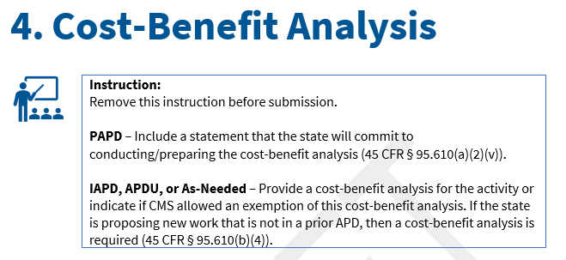
APD Section 4. Cost Benefit Analysis
Notes:
Section 4 is the Cost-Benefit Analysis, and again, what we expect here depends on where you are in the APD lifecycle.
For a Planning APD, you're committing to conduct and prepare the Cost-Benefit Analysis as part of the planning work.
When you move into an Implementation APD, APD Update, or As-Needed submission, the Cost-Benefit Analysis should be provided unless CMS has allowed for an exemption.
One thing I want to call attention to is new work. If you're proposing new activities that weren't included in a prior APD, don't assume that the previous Cost-Benefit Analysis automatically covers them. Consider whether the new work requires a Cost-Benefit Analysis as part of the current request.
The purpose here is to help CMS understand the costs of the proposed investment in relation to the benefits the Medicaid program expects to receive.

Slide 20
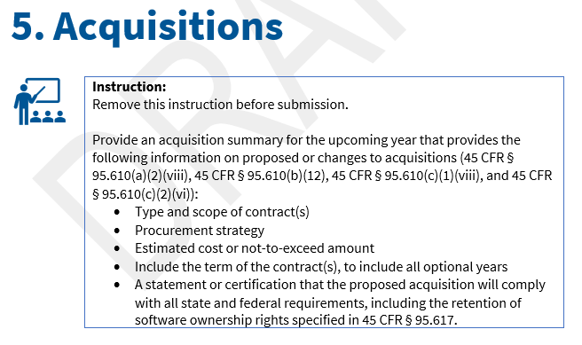
Section 5. Acquisitions
Notes:
Section 5 covers Acquisitions.
For any proposed acquisition or change to an acquisition, give us enough information to understand what you're procuring, how you plan to procure it, the anticipated cost, and the full term of the contract—including any optional years.
One thing I would encourage you to do here is be clear about where you are in the procurement or contracting process. If the procurement hasn't occurred yet, tell us that and provide the information that's available at the time of submission. If you're modifying or extending an existing acquisition, clearly identify what is changing.
Also make sure the acquisition information here aligns with the activities and funding you're requesting elsewhere in the APD. If the budget includes contractor costs, we should be able to understand what acquisition those costs relate to.
And remember that CMS prior approval should occur before the state or territory executes the contract or renewal. So don't wait until everything is signed to submit something that requires prior approval.
The goal is for us to understand the acquisition you're proposing, and the funding associated with it before the state or territory moves forward with that action.

Slide 21
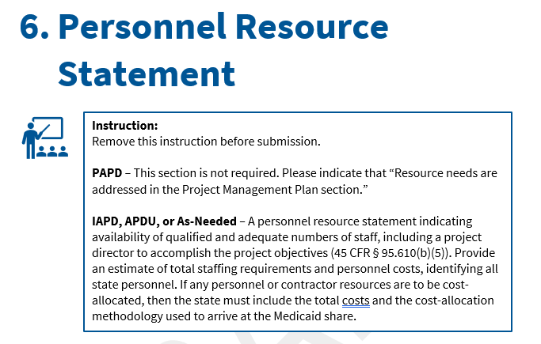
Section 6. Personnel Resource Statement
Notes:
Section 6 is the Personnel Resource Statement.
It's not required for a Planning APD because those resource needs are addressed in the Project Management Plan.
For the other APD types, we want to understand the staffing resources and costs supporting the project.
The next two slides show how the template breaks that down.

Slide 22
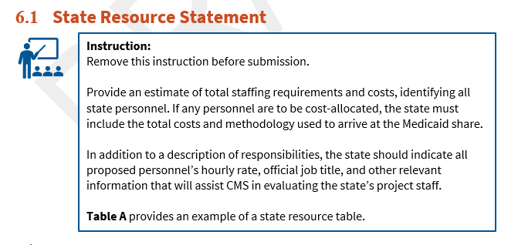
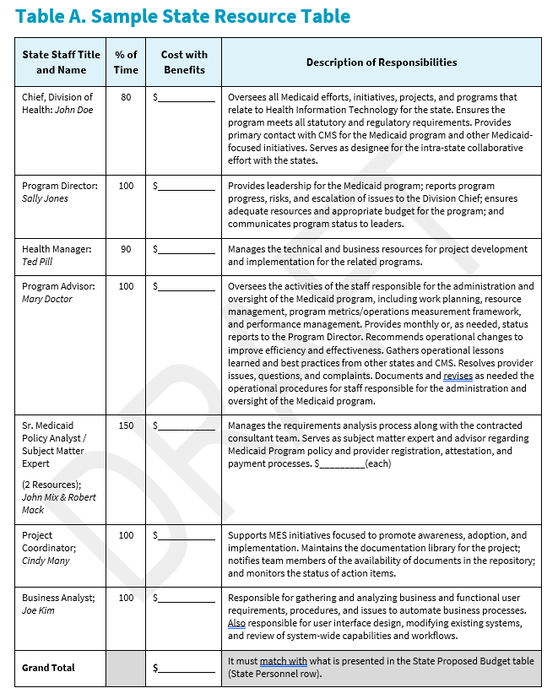
Section 6.1. State Resource Statement
Notes:
Section 6.1 focuses on state resources.
The template provides a sample table showing the staff member, percentage of time, cost with benefits, and responsibilities.
The table is an example.
The important thing is that CMS can understand who is supporting the project, what they're doing, and the associated cost.

Slide 23
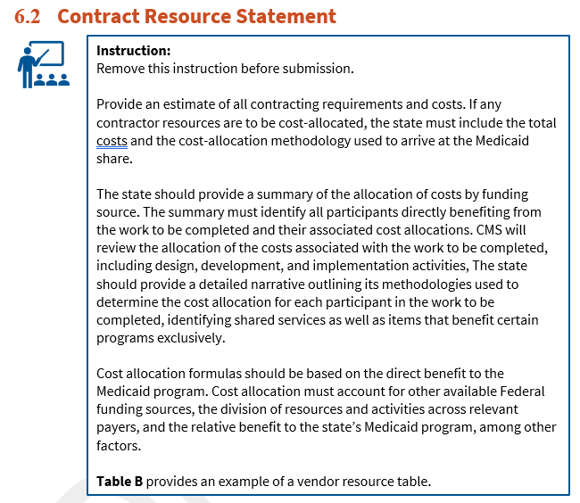
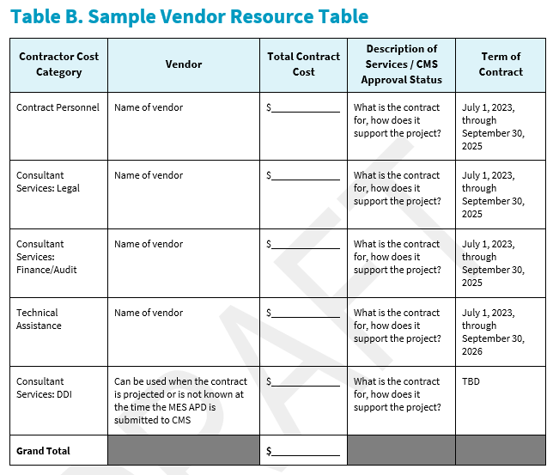
Section 6.2. Contract Resource Statement
Notes:
Section 6.2 does the same for contractor resources.
Again, we want to understand the vendor, services, total cost, and contract term.
If those costs benefit multiple programs, make sure the total cost and the methodology used to determine Medicaid's share are clear.

Slide 24
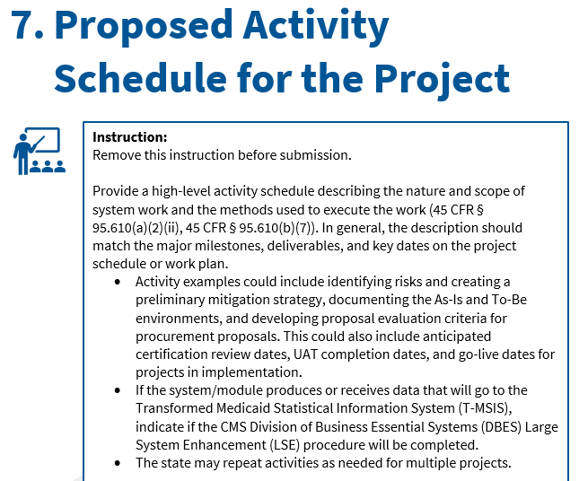
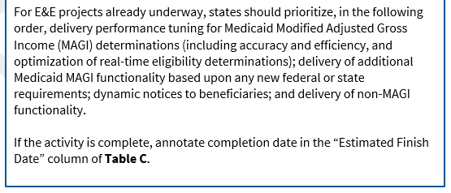
Section 7. Proposed Activity Schedule for the Project
Notes:
Section 7 is the Proposed Activity Schedule for the Project.
This is where we want to see the major activities, milestones, deliverables, and key dates associated with the work you're proposing. The template includes Table C to help organize that information.
The schedule should be high-level, but it should still give CMS enough information to understand the sequence and timing of the project and how the activities relate to the scope we're being asked to approve.
One thing I personally look for is consistency between the dates here and the dates everywhere else in the submission. If your narrative says implementation begins in one quarter, your schedule shows another, and your MDBT Table reflects costs beginning somewhere else, we're going to have questions.
And as we mentioned earlier, take one last look at the schedule before you submit. If dates have changed during development of the APD, update them rather than submitting milestones that you already know are no longer realistic.
For activities that have already been completed, make sure the completion date is reflected in Table C rather than continuing to show that activity as prospective work.

Slide 25
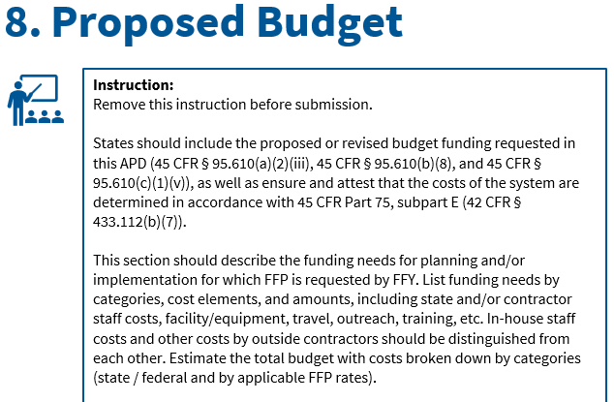
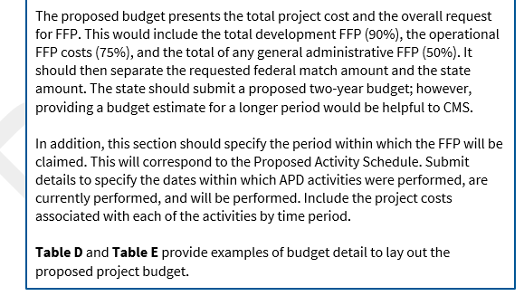
Section 8. Proposed Budget
Notes:
Section 8 is the Proposed Budget, and this is obviously a very important part of the funding request
.
This section should give us the overall financial picture of the project—what the project will cost, what you're requesting in FFP, and the period in which you expect to claim those costs.
The template includes Tables D and E as examples for presenting the budget detail. Those tables help break the request down by funding category, fiscal year, state and federal share, and applicable FFP rates.
And, of course, the proposed budget also needs to reconcile with your MDBT Table.
This is one area where I would really encourage you to do a final cross-check before submitting. The amount described in your transmittal and email, the APD narrative, the budget tables, and the MDBT Table should all represent the same funding request.
If you're requesting an increase or decrease from previously approved funding, clearly identify and explain that change. Don't make the reviewer compare multiple documents or APDs from previous years to figure out why the numbers changed.
Also make sure the timing of the funding makes sense in relation to the Proposed Activity Schedule. If you're requesting costs for an activity in a particular period, we should be able to see that activity occurring during that same period in the schedule.
The goal is that when CMS gets to the end of this section, we can clearly understand how much you're requesting, what it's for, when you expect to spend it, and the Federal Financial Participation rate being requested.

Slide 26
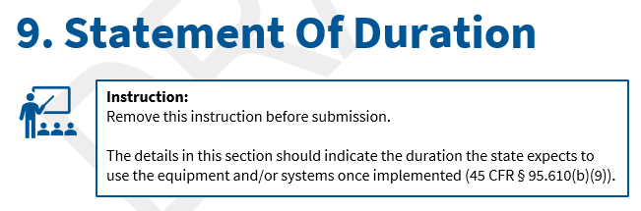
Section 9. Statement of Duration
Notes:
Section 9 is the Statement of Duration, and this one is fairly straight-forward.
Here, you're simply telling CMS how long the state expects to use the equipment or system once it's implemented.
This doesn't need to be a lengthy narrative. Just provide a clear, reasonable statement of the anticipated useful life or period of use for the system or equipment.

Slide 27
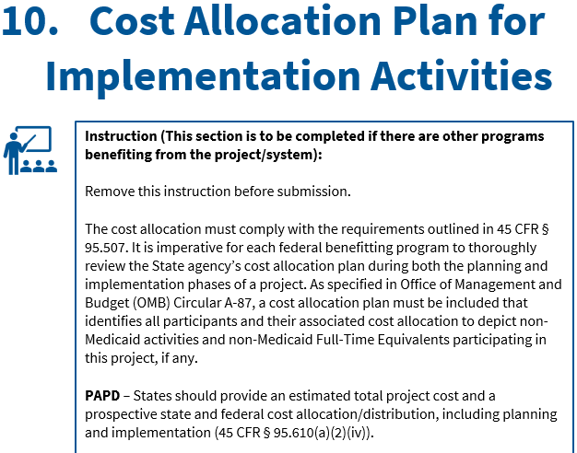
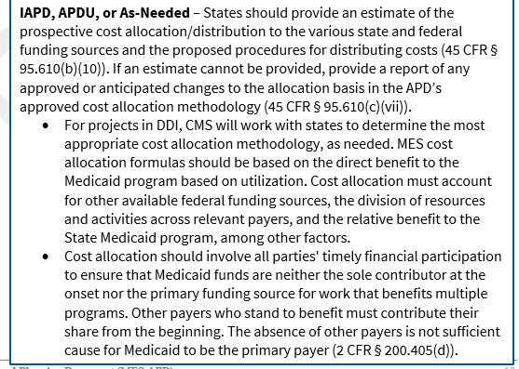
Section 10. Cost Allocation Plan for Implementation Activities
Notes:
Section 10 addresses cost allocation when programs other than Medicaid benefit from the project or system.
The basic principle is that costs should be allocated based on the relative benefit each participating program receives. Medicaid shouldn't automatically bear the full cost simply because another benefiting program doesn't have funding available or wasn’t asked to budget the cost.
For this section, make sure we can understand the total cost, who benefits, and the methodology used to determine Medicaid's share.
If you're changing a previously approved cost-allocation methodology, clearly explain what's changing and why.

Slide 28
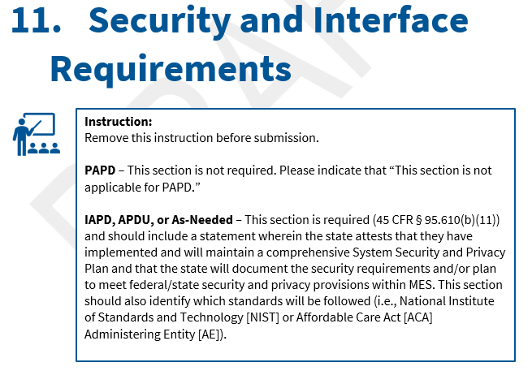
Section 11. Security and Interface Requirements
Notes:
For a Planning APD, this section isn't required.
For the other APD types, this is where the state addresses its System Security and Privacy Plan and applicable security and privacy standards.
And for those familiar with the old template, disaster recovery and business continuity are now addressed through the Conditions for Enhanced Funding in Appendix C.

Slide 29
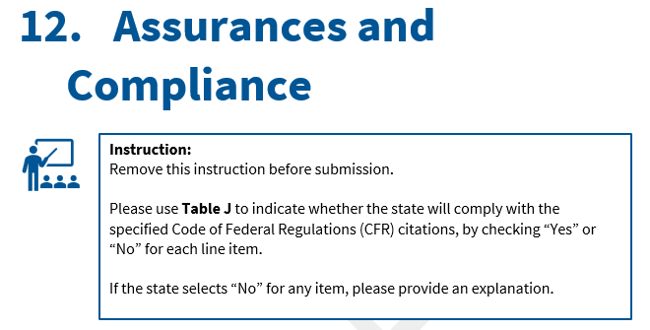
Section 12. Assurances and Compliance
Notes:
Section 12 uses Table J for the regulatory assurances
.
Complete each item Yes or No, and if you answer No, provide an explanation.
Also make sure you're using the current table, since the regulatory citations were updated in the new template.

Slide 30
APD Appendices
Appendix | Purpose
Appendix A — Diagram | System diagram supporting Section 3
Appendix B — Other Information Required | Supporting information, including the Analysis of Alternatives when applicable
Appendix C — Conditions for Enhanced Funding | Conditions for Enhanced Funding attestation
Appendix D — Outcomes and Metrics | CMS-required and state-defined outcomes and metrics
Appendix E — Certification | Determine whether work described in the APD requires certification
Notes:
Before we move to the OAPD, I don't want to skip the appendices because they're part of the APD package.
Appendix A is the system diagram supporting Section 3. Appendix B is for other required supporting information, including the Analysis of Alternatives when applicable. Appendix C addresses the Conditions for Enhanced Funding and the associated attestations.
Appendix D addresses CMS-required and state-defined outcomes and metrics, and Appendix E addresses the certification determination.
The important point is that these aren't disconnected attachments. They should align with the same project, scope, activities, and outcomes you've described throughout the APD.

Slide 31
OAPD Template Sections
Notes:
Now we're going to shift back to the OAPD.
As we discussed earlier, this template is intentionally much more streamlined. Let's take a quick look at the individual sections.

Slide 32
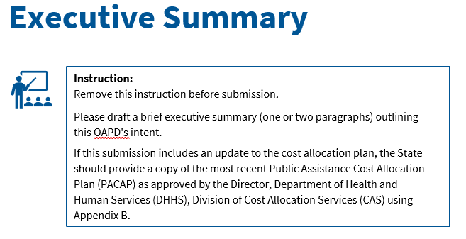
OAPD Section Executive Summary
Notes:
The OAPD also begins with a brief Executive Summary.
Just as I mentioned with the APD, one thing I personally find helpful is clearly stating the funding being requested up front, including the amount and period, and identifying any increase or decrease from previously approved funding.
This should be a concise snapshot of what you're asking CMS to approve for the upcoming operational period.

Slide 33
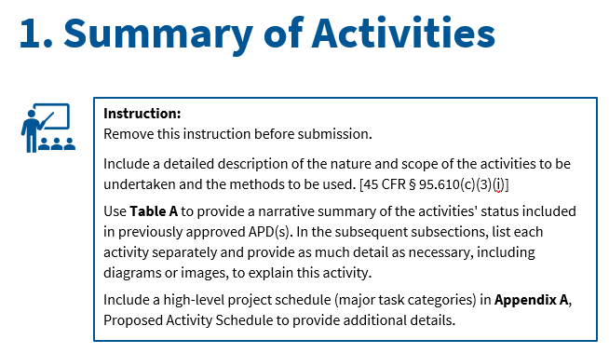
OAPD Section 1. Summary of Activities
Notes:
Section 1 is the Summary of Activities.
Here, we want to understand what you're planning to do during the upcoming operational period and how those activities relate to previously approved work.
Use Table A to summarize the status of previously approved activities, and be clear about what's continuing, what's complete, and what's changing.

Slide 34
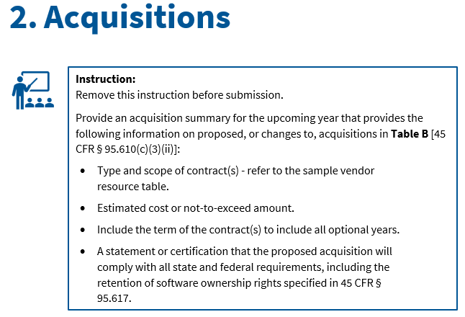
OAPD Section 2. Acquisitions
Notes:
The acquisition requirements here are very similar to what we discussed earlier, so I won't repeat them.
For the OAPD, focus on proposed acquisitions or changes for the upcoming year and provide that information in Table B.
Make sure those acquisitions align with the activities and funding elsewhere in the submission.

Slide 35
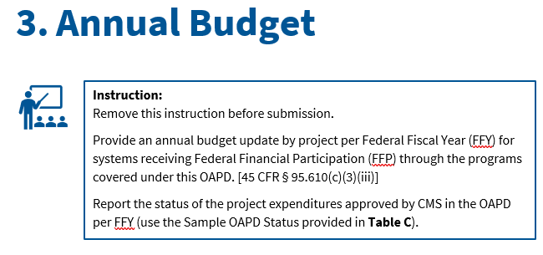
OAPD Section 3. Annual Budget
Notes:
And finally, the Annual Budget.
Again, we covered the general budget principles earlier. Here, provide the annual budget by project and Federal Fiscal Year and use Table C to report the status of previously approved expenditures.
The funding should align with the activities and acquisitions you've just described.

Slide 36

APD
FAQs
Notes:
The next few slides are FAQs that were collected during the PRA comment processing period and represent questions submitted directly from States to CMS.
This list is a subset of a broader…………………………………………………………………………………………more comprehensive MES Templates FAQ document being cleared for publication on Medicaid.gov.
I won’t read through them, but wanted to let you know that they will be available to reference and will be saved as part of this presentation.

Slide 37
APD FAQs (1 of 5)
Why were new APD, OAPD, and MDBT templates released?
New APD, OAPD, and MDBT templates were released to improve standardization of state submissions. The new MDBT template unifies Medicaid Management Information System (MMIS) and Eligibility and Enrollment (E&E) funding into a single MES view to reduce the number of files involved in the submission process and save time.
Why are there only APD and OAPD templates, rather than one for each type of APD?
States can use the new APD template for Planning APDs (PAPDs), Implementation APDs (IAPDs), APD updates (APDUs), and As-Needed APDs. The structure of the OAPD template is different and focuses on the submission requirements in the regulation. Please refer to 45 CFR 95.610.
The new APD, OAPD, and MDBT templates combine MMIS and E&E submissions. Will states be expected to combine submissions in the future?
CMS recommends that states combine submissions where applicable. If a project receives both E&E and MMIS funding, states should submit a single MES APD wherever feasible. The new APD and OAPD templates are flexible and can be used for either individual MMIS or E&E project funding, or for combined submissions when a project receives both types of funding. When using the new MDBT template, states should combine MMIS and E&E submissions into a single file, which reduces the number of files involved in the submission process.
Notes:
Just move

Slide 38
APD FAQs (2 of 5)
If states are submitting a Multi Op-Div APD (e.g., Administration for Children and Families, Food and Nutrition Service, etc.), can we modify the template to include their required information?
Yes, as long as it does not impact the required elements for the APDs, per 45 CFR 95.610. Contact your CMS MES SO if you have any questions
Can states include information in their APDs and OAPDs not required by the template?
Yes. States can use the optional “Appendix B” for additional supporting information that does not fit into any of the other required sections on the Office of Management and Budget-approved templates. CMS encourages states to follow the guidance and structure of the new templates. If states have concerns, they should contact their CMS MES SO for guidance.
Some states do not submit PAPDs and instead use IAPDs. Are states now expected to submit PAPDs using the new APD template?
CMS recommends that states submit standalone PAPDs in the initial phase of their projects. PAPDs are a valuable tool in the MES lifecycle and are codified in regulation. The new APD template provides improved guidance on how states can use the template for the PAPD submission.
Is every section in the new APD template required for all types of APDs submitted by states?
No. Not every section is required for all APD types. Each section of the new APD template includes guidance on what content is needed and when, based on the type of APD being submitted (PAPD, IAPD, APDU, or AsNeeded APD). States should follow the instructions within each section to determine what applies to their submission.
Notes:
Just move

Slide 39
APD FAQs (3 of 5)
How is “period” defined in the APD?
The claiming period for APDs is the Federal Fiscal Year (FFY) during which Federal Financial Participation (FFP) is requested and funding is approved. Under 42 CFR §430.30, states must also submit the CMS-64, the Quarterly Medicaid Statement of Expenditures for the Medical Assistance Program, within 30 days following the close of each quarter. The CMS-64 must account for all expenditures from that quarter, organized by service category and funding source.
What information should be included in Appendix B of the APD?
The ‘Other Information’ section in Appendix B can be used to provide any additional information in support of the APD update and funding request, such as a detailed analysis of alternatives, requirements analysis, or feasibility studies completed by the State Medicaid Agency to support the decision to implement the proposed system.
Must states submit an APD for each project in their annual update?
Yes. States must submit an APD for every project in their annual update. The new APD template allows states to document multiple projects in a single APD as part of their annual update submission. If multiple projects are included, the state should complete each section for each individual project and provide the appropriate project-specific MDBTs.
Notes:
Just move

Slide 40
APD FAQs (4 of 5)
Does commercial off the shelf (COTS) software receive a 90/10 match?
Yes. COTS software is eligible to receive a 90/10 federal financial participation match as described in 42 CFR 433.112(c)(2), “Design, development, installation, or enhancement costs include costs for initial licensing of commercial off the shelf (COTS) software, and the minimum necessary costs to analyze the suitability of COTS software, install, configure and integrate the COTS software, and modify non-COTS software to ensure coordination of operations. The nature and extent of such costs must be expressly described in the approved APD.”
What is the difference between customization and configuration? How should states split these in the Medicaid Detailed Budget Table (MDBT)?
Configuration is adjusting built-in settings and options in the software to meet your organization’s needs without changing its core code. Customization is modifying or adding code to change the software’s baseline system, usually to create new functionality that the software does not currently provide. Configuration and customization do not inherently require separation in the MDBT. In the MDBT, states should split costs based on in-house costs vs private sector contract costs as well as the project phase (design, development, and installation (DDI) vs. maintenance and operations (M&O)). It is recommended that states work with their CMS MES SO to discuss the best approach to this and reference the definition for Software Maintenance in 45 CFR 95.605.
Notes:
Just move

Slide 41
APD FAQs (5 of 5)
Should states continue to submit the MDBT with the OAPD?
Yes. All states are required to submit an MDBT with any OAPD submission. While the OAPD template does not include a standalone requirement to include the MDBT as a section in the OAPD, it should be a supplemental file to the OAPD. The MDBT is required to support the budget information reported in Section 3. Annual Budget, including Tables C–G. States should submit the corresponding MDBT with the OAPD to confirm approved funding even when no budget changes are being requested.
Is there a place in the template to note the assumptions for cost allocation?
Yes. Section 10, Cost Allocation Plan for Implementation Activities, of the new MES APD template provides space for states to describe their cost allocation approach, including any assumptions. The section also includes a sample cost allocations table. For more information on cost principles, refer to 2 CFR Part 200 and 2 CFR Part 300.
Notes:
Just move

Slide 42
Questions
Notes:
And with that, we'll open it up for questions.
I know we've covered a lot of information, so please feel free to ask questions about the templates, how the different APD types apply, or anything else we've discussed today.
And if you have a question that's very specific to your state's or territory's project or circumstances, we're also happy to continue that conversation with you and your State Officer after today's session.

Slide 43
Resources
Contact Information
Jessica Dunlap Jessica.dunlap@cms.hhs.gov
MES Operations team: MESOperations@cms.hhs.gov
Alejandra Johnson Alejandra.Johnson@cms.hhs.gov
MES Templates https://www.medicaid.gov/medicaid/data-systems/streamlining-medicaid-enterprise-systems-templates
Important Links
GitHub | CMS MES Certification Repository

